Slide 1
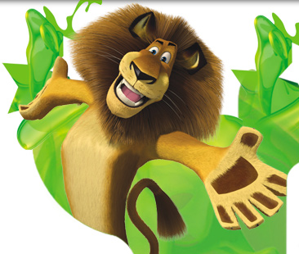
Computer Animation

Slide 2
What is Animation
* Refers to any time sequence of visual changes in a picture.
Can also display time variation in object size, color, transparency, surface texture.
Two methods to generate animation
1) Real time animation
2) Frame by Frame animation

Slide 3
Methods of animation
Real time animation
Each stage of animation is created and viewed
Must be generated at a rate convenient to refresh rate.
Simple animation are generated here.
Frame by Frame animation
Each frame is generated separately and stored.
Later frames are recorded in film and played.
More complex animation use this method.

Slide 4
Design of animation sequence
Storyboard layout
Object Definition
Key frames Specification
Generation of In-Between frames.
Additional Tasks
Transferring frames to film/Rendering
Shading, Lighting
Sound
Postproduction

Slide 5
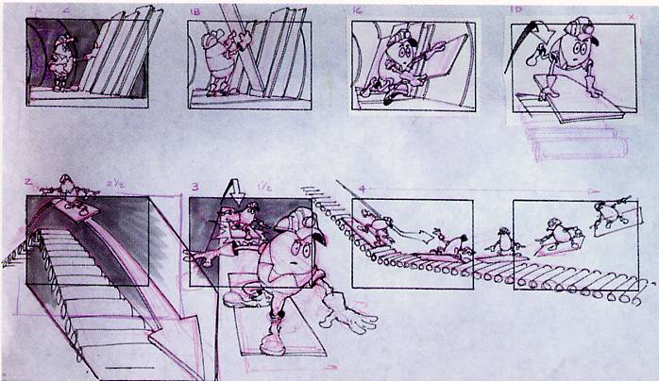
Story Board
Animation in outline form

Slide 6
Storyboard
Storyboard is an outline of the action. Story of the animation is written.
Defines motion sequence as a set of basic events that are to take place.
Consists of set of rough sketches, description of motions or actions.

Slide 7
Object definition
Here definition is given for each participant in the action.
Objects defined in terms of basic shapes like polygon, surfaces.

Slide 8
Key Frame Animation
Gives details of the scene at a certain time in animation sequence.
Define characters at extreme positions.
Development of key frames is responsibility of senior animators.

Slide 9
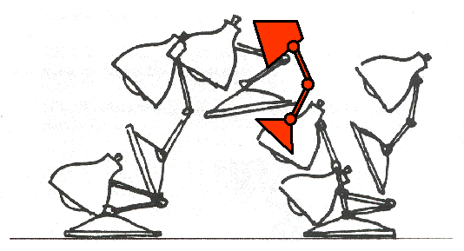
In Betweens
These are intermediates frames between the key frames.

Slide 10
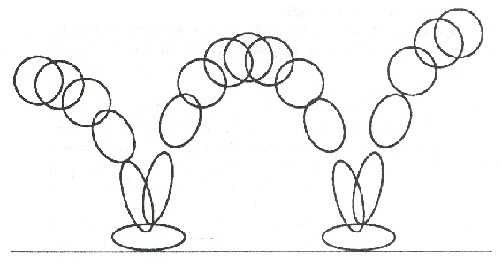
Traditional Animation techniques.
Squash and stretch: Indicates physical properties of an object by distortions of shape
Stretch
Squash

Slide 11
Traditional Animation techniques.
Timing: is the spacing between motion frames.
Slower moving object is represented with more closely spaced frames
Faster moving object is placed with fewer frames.
Slow In Slow Out: To help smooth interpolations .Jerky movements must be avoided.

Slide 12
Traditional Animation techniques.
Anticipation: object movements can be emphasized by preliminary actions that anticipates coming motion.
Eg: cartoon character may lean forward and rotate before starting to run.
Follow through action: Used to emphasize a previous motion.
Staging: Refers to method of focusing on an important part of scene, like a character hiding something.

Slide 13
Key Frame Systems
Used to generate a set of in-betweens from the specification of two or more key frames.

Slide 14
Key Frame Systems
The simplest method of in-betweening is linear interpolation.
interpolation is a method of constructing new data points within the range of a discrete set of known data points.
Linear Interpolation : is given by
V_{t}=(1-t)v_{s}+tv_{e}
_{Spline interpolation:}
V_{t}=(1-f(t))v_{s}+f(t)v_{e}

Slide 15
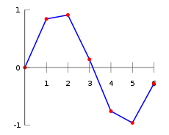
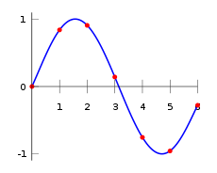
Linear interpolation Spline interpolation

Slide 16
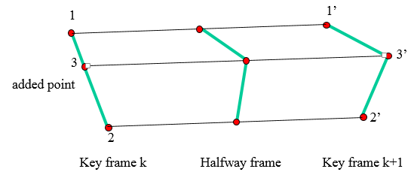
Key Frame Systems
Transformation of objects shape from one form to another is called morphing

Slide 17
Key Frame Systems
Preprocessing rules for interpolation to equalize key frames in terms of number of vertex or edges.
Equalizing number of edges:
L_{max}=max(L_{k},L_{k+1}) L_{min}=min(L_{k}+L_{K+1} )
Compute two quantities
Ne=L_{max}mod L_{min}
Ns=int(L_{max}/L_{min)}

Slide 18
Key Frame Systems
Follow the following two procedure
1) Divide N_{e} edges of Keyframe _{min} into N_{s}+1 sections
2) Divide the remaining lines of keyframes _{min} into N_{s} sections.
Similarly we can do for vertex equalizing
V_{max}=max(V_{k},V_{k+1}) V_{min}=min(V_{k}+V_{K+1} )
Compute two quantities
Nls=(V_{max}-1)mod (V_{min}-1)
Np=int(V_{max}-1)/(V_{min}-1)

Slide 19
Perform the following two procedures
Add N_{p} points to N_{ls} line sections of
keyframe_{min}
Add N_{p}-1 points to the remaining edges of keyframe_{min}.

Slide 20
Motion Specification
Animation can be controlled or described by
Full Explicit control: Here animator describes every details.
Highly automated control: Provided by knowledge based system, that takes high level description of animation and generate explicit controls to generate animations.

Slide 21
Motion specification
1) Direct Motion Specification: One of the straightforward method to specify geometrical transformation parameters.
Explicitly specify values for transformation (rotation angle, translation vector).
Suitable for simple user programmed animation sequence.

Slide 22
Motion specification
2) Goal Directed system:
Specify the motions taken in terms of the final result.
Values for the motion parameters are determined from the goal of the animation.
EG: “walk to the door” is a goal than, the motion required of the torso and limbs to accomplish this action are calculated.

Slide 23
Motion specification
Procedural control
This is based on the communication between various objects to determine their properties. Eg: Position of grass blades were determined by wind particles.
This control is a significant part of several other control mechanisms.
For example in physically -based system the position of one object may influence the motion of the other object.(Ball cannot pass through wall)
In actor -based systems the individual actors may pass their position to other actors to affect the other actor’s behaviour. (Engine of train)

Slide 24
Motion specification
Constraint -based systems
Many object in nature move according to the influence of other object and hence the motion may not be Linear always.
Such motions may be modeled by constraints.
Specifying an animated sequence using constraint is much easier to do than using explicit control.
Eg: Ball rolls down the inclined plane.

Slide 25
Tracking live action
Trajectories of objects in the course of an animation can also be generated by tracking live action
Traditional animation uses rotoscoping: A film is made where people act out the characters of animation, then animators draw over the film. Then the humans are replaced by animation characters.
Another live-action technique is to attach some sort of indicator ,say sensor, to key points on a person’s body and get the location for key points in animation model.

Slide 26
Kinematics and Dynamics
In kinematics We specify animation by motion parameters like position, velocity, acceleration.
Kinematics refers to the position and velocity of points.
A kinematical description of a scene for example may be of the form
“The ball is at the origin at time t =0
It moves with a constant acceleration in the direction (1 ,2, 7) there after

Slide 27
Kinematics and Dynamics
Dynamics.. Take in to accounts the physical laws that govern the kinematics like the
Newton’s Law of motion
Euler -LaGrange equation for fluid
The dynamics description of a scene may be as follows:
a) At time t= 0 seconds the ball is at position
( o meters , 100 meters , 0 meters)
The ball has a mass of 1729 grams.
The force of gravity acts on the ball
d) Naturally the result of a dynamic simulation of such a model is that the ball falls.

